Slide 1
CSE 403
Design Patterns and GUI Programming
Reading:
Object-Oriented Design and Patterns, Ch. 5 (Horstmann)
These lecture slides are copyright (C) Marty Stepp, 2007. They may not be rehosted, sold, or modified without expressed permission from the author. All rights reserved.

Slide 2
Design challenges
Designing software for reuse is hard; one must find:
  a good problem decomposition, and the right software abstractions
  a design with flexibility, modularity and elegance
designs often emerge from an iterative process
(trials and errors)
successful designs do exist
  two designs they are almost never identical
  they exhibit some recurring characteristics
The engineering perspective: can designs be described, codified or standardized?
  this would short circuit the trial and error phase
  produce "better" software faster

Slide 3
Design patterns
design pattern: a solution to a common software problem in a context
  example: Iterator pattern
  The Iterator pattern defines an interface that declares methods for sequentially accessing the objects in a collection.

Slide 4
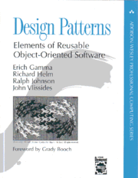
History of patterns
the concept of a "pattern" was first expressed
in Christopher Alexander's work A Pattern
Language in 1977 (2543 patterns)
in 1990 a group called the Gang of Four or "GoF"
(Gamma, Helm, Johnson, Vlissides) compile a
catalog of design patterns
1995 book Design Patterns:
Elements of Reusable Object-Oriented
Software is a classic of the field

Slide 5
More about patterns
A pattern describes a recurring software structure
  is abstract from concrete design elements such as problem domain, programming language
  identifies classes that play a role in the solution to a problem, describes their collaborations and responsibilities
  lists implementation trade-offs
  patterns are not code or designs; must be instantiated/applied
the software engineer is required to:
  evaluate trade-offs and impact of using a pattern in the system
  make design and implementation decision how best to apply the pattern, perhaps modify it slightly
  implement the pattern in code and combine it with others

Slide 6
Benefits of using patterns
patterns are a common design vocabulary
  allows engineers to abstract a problem and talk about that abstraction in isolation from its implementation
  embodies a culture; domain-specific patterns increase design speed
patterns capture design expertise and allow that expertise to be communicated
  promotes design reuse and avoid mistakes
improve documentation (less is needed) and understandability (patterns are described well once)

Slide 7
Gang of Four (GoF) patterns
Creational Patterns
(concerned with abstracting the object-instantiation process)
  Factory Method Abstract Factory Singleton
  Builder Prototype
Structural Patterns
(concerned with how objects/classes can be combined to form larger structures)
  Adapter Bridge Composite
  Decorator Facade Flyweight
  Proxy
Behavioral Patterns
(concerned with communication between objects)
  Command Interpreter Iterator
  Mediator Observer State
  Strategy Chain of Responsibility Visitor
  Template Method

Slide 8
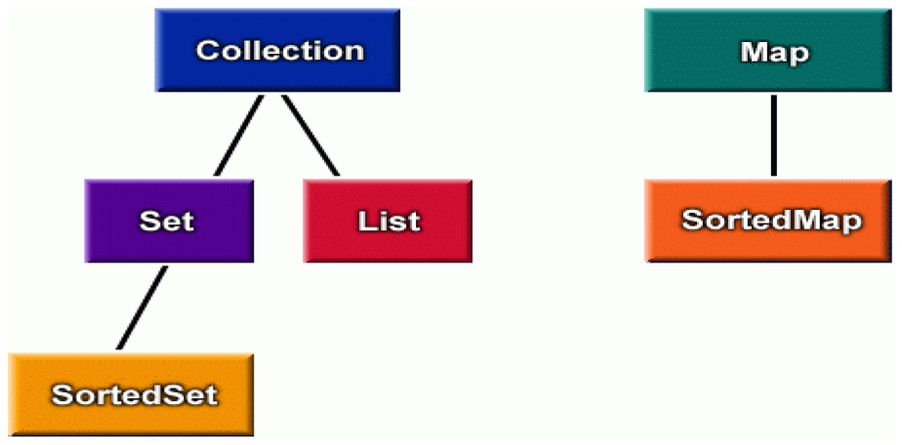
Pattern: Iterator
objects that traverse collections

Slide 9
Iterator pattern
iterator: an object that provides a standard way to examine all elements of any collection
benefits:
  uniform interface for traversing many different data structures without exposing their implementations
  supports concurrent iteration and element removal
  removes need to know about internal structure of collection or different methods to access data from different collections

Slide 10
Iterator interfaces in Java
package java.util;
public interface Iterator<E> {
public boolean hasNext();
public E next();
public void remove();
}
public interface Collection<E> {
... // List, Set extend Collection
public Iterator<E> iterator();
}
public interface Map<K, V> {
...
public Set<K> keySet(); // keys,values are Collections
public Collection<E> values(); // (can call iterator() on them)
}

Slide 11
Iterators in Java
all Java collections have a method iterator that returns an iterator for the elements of the collection
can be used to look through the elements of any kind of collection (an alternative to for loop)
List<Account> list = new ArrayList<Account>();
// ... add some elements ...
for (Iterator<Account> itr = list.iterator(); itr.hasNext(); ) {
Account a = itr.next();
System.out.println(a);
}
// or, using Java 1.5's foreach loop:
for (Account a : list) {
System.out.println(a);
}
set.iterator()
map.keySet().iterator()
map.values().iterator()

Slide 12
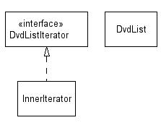
Adding your own Iterators
When implementing your own collections, it can be convenient to use iterators.
  discouraged (has nonstandard interface):
public class PlayerList {
public int getNumPlayers() { ... }
public boolean empty() { ... }
public Player getPlayer(int n) { ... }
}
  preferred:
public class PlayerList {
public Iterator<Player> iterator() { ... }
public int size() { ... }
public boolean isEmpty() { ... }
}

Slide 13
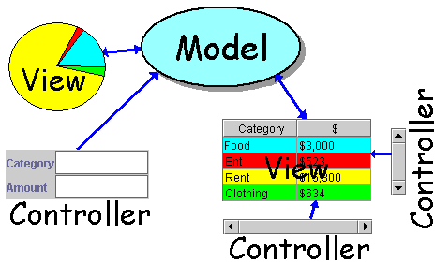
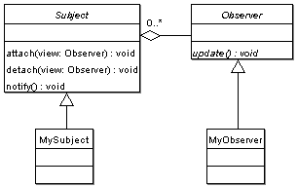
Pattern: Observer
objects whose state can be watched

Slide 14
Recall: model and view
model: classes in your system that are related to the internal representation of the state of the system
  often part of the model is connected to file(s) or database(s)
  examples (card game): Card, Deck, Player
  examples (bank system): Account, User, UserList
view: classes in your system that display the state of the model to the user
  generally, this is your GUI (could also be a text UI)
  should not contain crucial application data
  Different views can represent the same data in different ways
    Example: Bar chart vs. pie chart
  examples: PokerPanel, BankApplet

Slide 15
Model-view-controller
model-view-controller (MVC): common design paradigm for graphical systems
controller: classes that connect model and view
  defines how user interface reacts to user input (events)
  receives messages from view (where events come from)
  sends messages to model (tells what data to display)
  sometimes part of view (see left)
data for rendering
Model
View
View
Component
Model
updates
events
Controller
Controller

Slide 16
Observer pattern
observer: an object that "watches" the state of another object and takes action when the state changes in some way
  examples in Java: event listeners; java.util.Observer
observable object: an object that allows observers to examine it (often the observable object notifies the observers when it changes)
  permits customizable, extensible event-based behavior for data modeling and graphics

Slide 17
Benefits of observer
abstract coupling between subject and observer; each can be extended and reused individually
dynamic relationship between subject and observer; can be established at run time (can "hot-swap" views, etc) gives a lot more programming flexibility
broadcast communication: notification is broadcast automatically to all interested objects that subscribed to it
Observer can be used to implement model-view separation in Java more easily

Slide 18
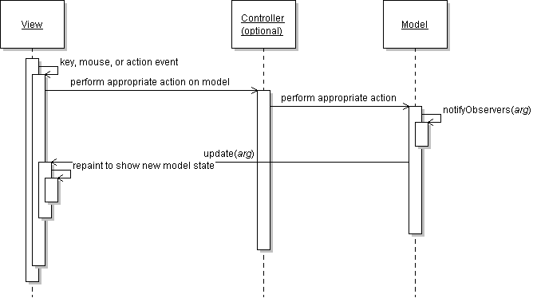
Observer sequence diagram

Slide 19
Observer interface
package java.util;
public interface Observer {
public void update(Observable o, Object arg);
}
Idea: The update method will be called when the observable model changes, so put the appropriate code to handle the change inside update

Slide 20
Observable class
public void addObserver(Observer o)
public void deleteObserver(Observer o)
Adds/removes o to/from the list of objects that will be notified (via their update method) when notifyObservers is called.
public void notifyObservers()
public void notifyObservers(Object arg)
Inform all observers listening to this Observable object of an event that has occurred. An optional object argument may be passed to provide more information about the event.
public void setChanged()
Flags the observable object as having changed since the last event; must be called each time before calling notifyObservers.

Slide 21
Common usage of Observer
1. write a model class that extends Observable
  have the model notify its observers when anything significant happens
2. make all views of that model (e.g. GUI panels that draw the model on screen) into observers
  have the panels take action when the model notifies them of events (e.g. repaint, play sound, show option dialog, etc.)

Slide 22
Using multiple views
make an Observable model
write a View interface or abstract class
  make View an observer
extend/implement View for all actual views
  give each its own unique inner components and code to draw the model's state in its own way
provide mechanism in GUI to set view (perhaps through menus)
  to set view, attach it to observe the model

Slide 23
Example: changing views
// in the frame's action listener:
// hide old view; show new one
model.deleteObserver(view1);
model.addObserver(view2);
view1.setVisible(false);
view2.setVisible(true);

Slide 24
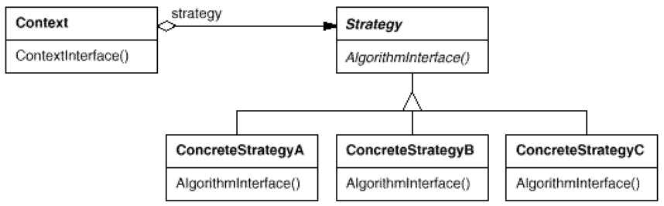
Pattern: Strategy
objects that hold alternate algorithms to solve a problem

Slide 25
Strategy pattern
strategy: an algorithm separated from the object that uses it, and encapsulated as its own object
  each strategy implements one behavior, one implementation of how to solve the same problem
  separates algorithm for behavior from object that wants to act
  allows changing an object's behavior dynamically without extending / changing the object itself
examples:
  file saving/compression
  layout managers on GUI containers
  AI algorithms for computer game players
Notes:
difference from Command pattern:
command objects each solve different problems
strategy objects all solve the same problem in different ways

Slide 26
Strategy example: Card player
// Strategy hierarchy parent
// (an interface or abstract class)
public interface Strategy {
public Card getMove();
}
// setting a strategy
player1.setStrategy(new SmartStrategy());
// using a strategy
Card p1move = player1.move(); // uses strategy

Slide 27
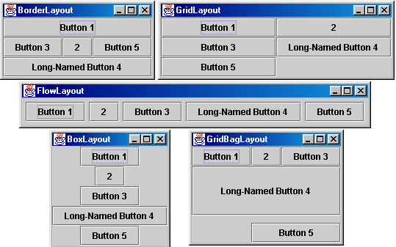
Strategies and GUI layout
How does the programmer specify where each component sits in a GUI window, how big each component should be, and what the component should do if the window is resized / moved / maximized / etc.?
Absolute positioning (C++, C#, others):
Specify exact pixel coordinates for every component
Layout managers (Java):
Have special objects that decide where to position each component based on some criteria
  What are benefits or drawbacks to each approach?

Slide 28
Containers with layout
The idea: Place many components into a special component called a container, then add the container to the window frame

Slide 29
Container
container: an object that holds components; it also governs their positions, sizes, and resize behavior
public void add(Component comp)
public void add(Component comp, Object info)
Adds a component to the container, possibly giving extra information about where to place it.
public void remove(Component comp)
Removes the given component from the container.
public void setLayout(LayoutManager mgr)
Uses the given layout manager to position the components in the container.
public void validate()
You should call this if you change the contents of a container that is already on the screen, to make it re-do its layout.

Slide 30
JPanel
A panel is our container of choice; it is a subclass of Container, so it inherits the methods from the previous slide and defines these additional methods (among others):
public JPanel()
Constructs a panel with a default flow layout.
public JPanel(LayoutManager mgr)
Constructs a panel that uses the given
layout manager.

Slide 31

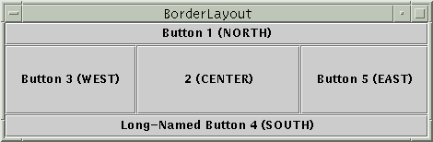
Preferred size of components
Swing component objects each have a certain size they would "like" to be--just large enough to fit their contents (text, icons, etc.)
  This is called the preferred size of the component
  Some types of layout managers (e.g. FlowLayout) choose to size the components inside them to the preferred size; others (e.g. BorderLayout, GridLayout) disregard the preferred size and use some other scheme
Buttons at preferred size: Not preferred size:

Slide 32
BorderLayout
public BorderLayout()
divides container into five regions: NORTH, SOUTH, WEST, EAST, CENTER
NORTH and SOUTH regions expand to fill region horizontally, and use preferred size vertically
WEST and EAST regions expand to fill region vertically, and use preferred size horizontally
CENTER uses all space not occupied by others
Container panel = new JPanel(new BorderLayout());
panel.add(new JButton("Button 1 (NORTH)", BorderLayout.NORTH);

Slide 33
FlowLayout
public FlowLayout()
treats container as a left-to-right, top-to-bottom "page" or "paragraph"
components are given their preferred size both horizontally and vertically
components are positioned in order added
if too long, components wrap around to next line
Container panel = new JPanel(new FlowLayout());
panel.add(new JButton("Button 1"));

Slide 34
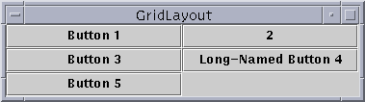
GridLayout
public GridLayout(int rows, int columns)
treats container as a grid of equally-sized rows and columns
components are given equal horizontal / vertical size, disregarding preferred size
can specify 0 rows or columns to indicate expansion in that direction as needed

Slide 35
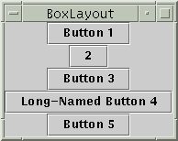
BoxLayout
Box.createHorizontalBox()
Box.createVerticalBox()
aligns components in container in a single row or column
components use preferred sizes and align based on their preferred alignment
preferred way to construct a container with box layout:
Box.createHorizontalBox(); or Box.createVerticalBox();

Slide 36

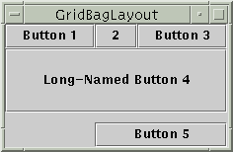
Other layouts
CardLayout
layers of "cards" stacked
on top of each other;
one visible at a time
GridBagLayout
very complicated;
my recommendation:
never ever use it
custom / null layout
allows you to define absolute positions using
setX/Y and setWidth/Height

Slide 37
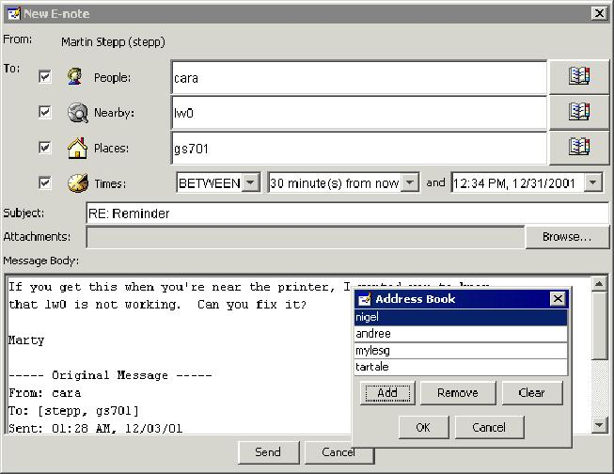
Problem with layout managers
How would you create a complex window like this, using the layout managers shown?

Slide 38
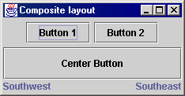
Solution: composite layout
create panels within panels
each panel has a different layout, and by combining the layouts, more complex / powerful layout can be achieved
example:
  how many panels?
  what layout in each?

Slide 39
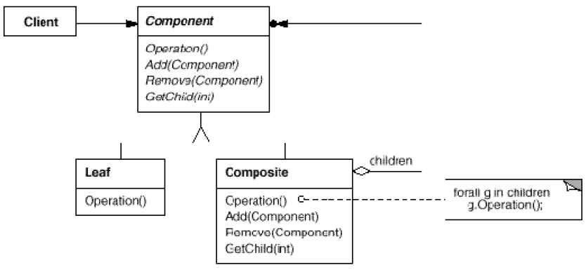
Pattern: Composite
objects that can serve as containers, and can hold other objects like themselves

Slide 40
Composite pattern
composite: an object that is either an individual item or a collection of many items
  composite objects can be composed of individual items or of other composites
  recursive definition: objects that can hold themselves
  often leads to a tree structure of leaves and nodes:
    <node> ::= <leafnode> | <compositenode>
    <compositenode> ::= <node>*
examples in Java:
  collections (a List of Lists)
  GUI layout (panels containing panels containing buttons, etc.)

Slide 41
Composite example: panels
Container north = new JPanel(new FlowLayout());
north.add(new JButton("Button 1"));
north.add(new JButton("Button 2"));
Container south = new JPanel(new BorderLayout());
south.add(new JLabel("Southwest"), BorderLayout.WEST);
south.add(new JLabel("Southeast"), BorderLayout.EAST);
// overall panel contains the smaller panels (composite)
JPanel overall = new JPanel(new BorderLayout());
overall.add(north, BorderLayout.NORTH);
overall.add(new JButton("Center Button"), BorderLayout.CENTER);
overall.add(south, BorderLayout.SOUTH);
frame.add(overall);

Slide 42
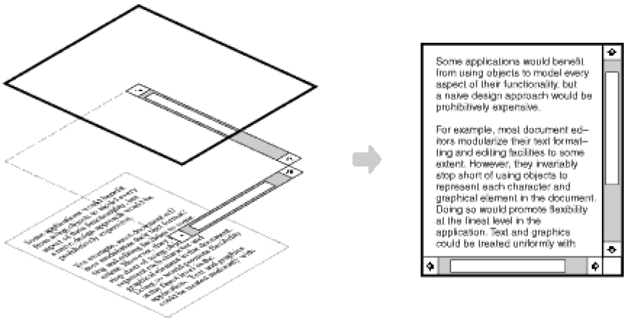
Pattern: Decorator
objects that wrap around other objects to add useful features

Slide 43
Decorator pattern
decorator: an object that modifies behavior of, or adds features to, another object
  decorator must maintain the common interface of the object it wraps up
  used so that we can add features to an existing simple object without needing to disrupt the interface that client code expects when using the simple object
  the object being "decorated" usually does not explicitly know about the decorator
examples in Java:
  multilayered input streams adding useful I/O methods
  adding scroll bars to GUI controls

Slide 44
Decorator example: I/O
normal InputStream class has only public int read() method to read one letter at a time
decorators such as BufferedReader or Scanner add additional functionality to read the stream more easily
// InputStreamReader/BufferedReader decorate InputStream
InputStream in = new FileInputStream("hardcode.txt");
InputStreamReader isr = new InputStreamReader(in);
BufferedReader br = new BufferedReader(isr);
// because of decorator streams, I can read an
// entire line from the file in one call
// (InputStream only provides public int read() )
String wholeLine = br.readLine();

Slide 45
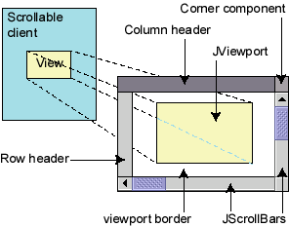
Decorator example: GUI
normal GUI components don't have scroll bars
JScrollPane is a container with scroll bars to which you can add any component to make it scrollable
// JScrollPane decorates GUI components
JTextArea area = new JTextArea(20, 30);
JScrollPane scrollPane = new JScrollPane(area);
contentPane.add(scrollPane);
  JComponents also have a setBorder method to add a "decorative" border. Is this another example of the Decorator pattern? Why or why not?

Slide 46
References
The Java Tutorial: Visual Index to the Swing Components.
http://java.sun.com/docs/books/tutorial/
uiswing/components/components.html
The Java Tutorial: Laying Out Components Within a Container.
http://java.sun.com/docs/books/tutorial/uiswing/
layout/index.html
Java Class Library Reference: Observer, Observable.
http://java.sun.com/j2se/1.5.0/docs/api/java/util/Observer.html
http://java.sun.com/j2se/1.5.0/docs/api/java/util/Observable.html
Cunningham & Cunningham OO Consultancy, Inc.
  http://c2.com/cgi/wiki?IteratorPattern
  http://c2.com/cgi/wiki?DecoratorPattern
  http://c2.com/cgi/wiki?CompositePattern
Design Patterns Java Companion
  http://www.patterndepot.com/put/8/JavaPatterns.htm

